Slide 1

NLP News Intelligence Anomaly radar
Presenter
Geetha Palanisamy
MDTM46B

Slide 2

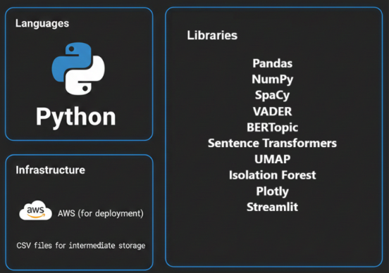
PROJECT OVERVIEW
PROJECT GOAL
Build a platform to detect suspicious narratives, monitor trends, and assess brand risk from news articles.
This provide analysts with early warning signals of disinformation and reputational exposure.
TOOLS USED
Project Structure
Step 1: Data ingestion → raw news dataset
Step 2: Preprocessing → cleaning text, normalizing locations
Step 3: Feature engineering → sentiment, topics, temporal signals
Step 4: Anomaly detection → linguistic, location, temporal
Step 5: Aggregation → article labels, brand risk scores
Step 6: Visualization → UMAP clusters, dashboards
Step 7: Deployment → Streamlit, AWS

Slide 3
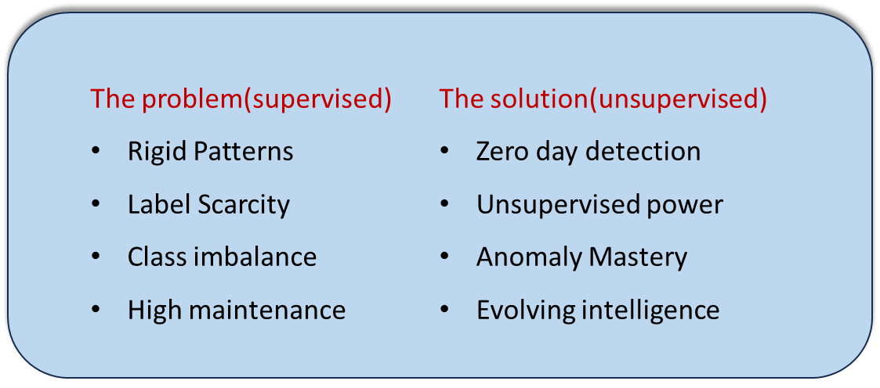
Why chose Unsupervised model?
Unlike supervised detection that only recognize known patterns of fake news, unsupervised isolation forest can detect Zero-day disinformation
It overcomes label scarcity
Supervised models often struggle with extreme class imbalance
Reduced the need of constant model retraining
Supervised classifiers miss the mark on unknowns. Our NLP News Intelligence Radar uncovers hidden patterns with isolation forest and Z score thresholding staying ahead of evolving disinformation that rigid models ignore

Slide 4


DATA HANDLING
Data Cleaning
Removed URLs, punctuation, and special characters so the text is easier to analyze.
Converted everything to lowercase for consistency.
Removed common filler words (like “the”, “and”, “is”) that don’t add meaning.
Applied lemmatization: turning words into their base form (e.g., “running” → “run”).
Why: Clean text ensures that our models focus on meaning, not noise.
Location Extraction
SpaCy Named Entity Recognition (NER) is a pretrained model to detect entities like GPE (Geo‑Political Entity), LOC (location), and ORG. Example: “US oil prices slip below 50” → SpaCy tags “US” as a GPE
GeoText :A lightweight python library that scans text for city and country names. Example: “England football fans party in Lille” → GeoText extracts “England” and “Lille”.
Normalization :After extraction, standardized names (e.g., “US”, “USA”, “United States” → “United States”) as Consistency is critical for anomaly detection — otherwise “US” vs “USA” would look like different places.

Slide 5
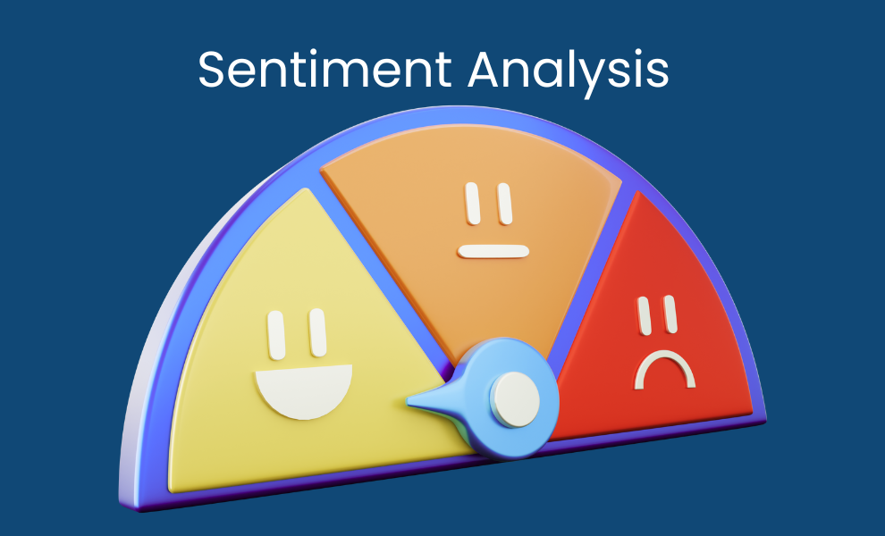

FEATURE ENGINEERING
Sentiment Analysis
VADER (Valence Aware Dictionary and sEntiment Reasoner) is a nltk module used for sentiment analysis
Lexicon-based approach: VADER has a dictionary of words with pre‑assigned sentiment scores (positive, negative, neutral). Example: “great” = +3.0, “terrible” = −3.0.
Why best Approach? : No training needed, Fast and light weight, Transparent and explainable even for short text
Temporal Features
Extracted year, month, and weekday from the article date.
Counted how many articles appeared per day.
Why: Sudden spikes in volume often indicate coordinated campaigns.

Slide 6

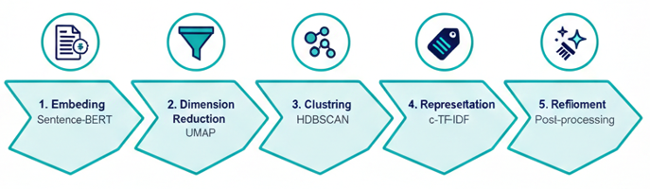
FEATURE ENGINEERING
Topic Extraction – BERTopic
Why?- capture meaning not just frequency like LDA
Steps involved
Sentence transformer read each document and output a vectors of numbers called an embedding (through semantic analysis-similar meaning)
This vector captures meaning of text in a high dimensional space
UMAP takes this high dimensional embeddings and compress them into a small vector(2/5D) , but groups similar text close, dissimilar texts far
Now BERTopic via DBSCAN, clusters these reduced vectors as 0,1,2…until this step there is no text label, all words are in semantic encoding(i.e.numbers)
Now, BERTopic takes the original text of that cluster and merge them into single document and run its c-TF-IDF to find the most representative words for that cluster (number to words form)
Top scoring words in that cluster (e.g:refund, delay,shipment) are selected as keywords of that topic
After seeing these keywords of a cluster human gives short topic name

Slide 7
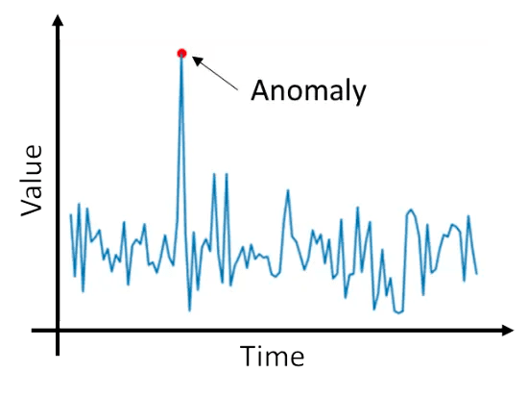
ANOMALY DETECTION
Temporal Anomaly
For temporal anomaly detection: rolling mean + rolling standard deviation with z‑score thresholding.
Rolling mean/std: Calculates the average and variability of article counts over a moving window (e.g., 7 days).
Z‑score: Measures how far today’s article count deviates from the rolling average in terms of standard deviations.
Threshold: If the z‑score exceeds a set value (e.g., >2), it’s flagged as a temporal anomaly.
Why temporal features matter?
Disinformation campaigns often spike suddenly — many articles appear in a short time to push a narrative.
Normal news cycles are smoother — gradual coverage over time.
Temporal anomalies highlight coordination — e.g., 50 articles about the same protest appearing overnight.
🔄 Alternatives you could have used:
ARIMA / Prophet (time series forecasting): Predict expected counts, flag deviations. More complex, less transparent.

Slide 8

ANOMALY DETECTION
Linguistic Anomaly
Isolation Forest is an unsupervised machine-learning algorithm based on the idea that anomalies are rare and different from normal data points.
Features: text length, tone, and topic meaning.
Mechanism:
Step 1 — Represent each article: Every article is converted into a profile using these features.
Step 2 — Build random trees: The algorithm creates many random decision trees that split articles based on
these features.
Step 3 — Isolation principle:
  Articles that resemble most others require many splits before they can be separated.
  Articles that differ clearly are isolated quickly in fewer splits.
Step 4 — Anomaly scoring: Articles that are consistently isolated faster across many trees receive higher anomaly
scores. These are flagged as potential anomalies.
Why isolation forest?
It does not require labeled data to train.
It explicitly targets anomalies rather than profiling normal points.

Slide 9

ANOMALY DETECTION
Location Anomaly
en_core_web_sm, a pre-trained English language model provided by the SpaCy library, and it is used to perform Named Entity Recognition (NER)
Rule‑based comparison: Simple string/semantic match between headline location and body location.
Binary anomaly flag: 0 = normal, 1 = anomaly.
Why location anomaly matters
Disinformation tactic: Fake stories often recycle content but swap locations to mislead readers.
Explainability: Easy for analysts to verify — “Headline says London, body says Paris.”
Transparency: Non‑technical clients can immediately understand why it’s flagged.
Business relevance: Location mismatches can damage trust in reporting and mislead audiences about where events occur.

Slide 10
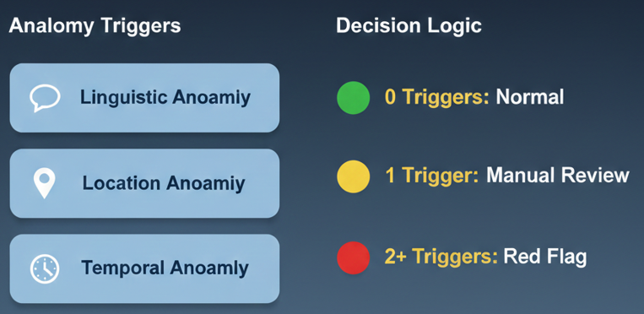
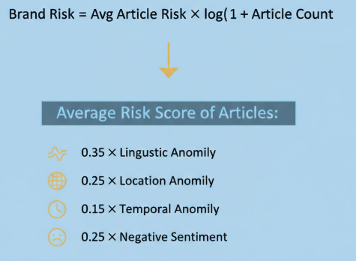
AGGREGATION
Why?
Transparent and easy
Provides clear visibility to specific triggers
Final Label
0.35 : Unusual wording is often the clearest sign of manipulation.
0.25 : Location mismatches and negative sentiment are equally important — they directly affect trust and reputation.
0.15 : volume alone doesn’t always mean risk.
Brand Risk Score

Slide 11
EVALUATION METRICS
How Well Does Our Risk Detection Work?
Metric | Score | Key Takeaway | Insight
ROC_AUC | 1 | Perfect Discrimination | Our model perfectly distinguishes between suspicious and normal articles.
PR_AUC | 1 | High Precision Balance | Even when risky articles are rare, we detect them with maximum confidence.
Precision | 1 | Zero False Alarms | 100% of flagged articles are truly risky; no time is wasted on false positives.
F1 Score | 0.06 | Precision-Heavy | We currently prioritize extreme accuracy over total volume.
Recall@200 | 24% | Targeted Review | Reviewing the top 200 articles catches nearly a quarter of all known risks.
Key Takeaway
This is not a bulk detection tool — it is a decision-support system. It delivers accurate, explainable, and actionable alerts, enabling faster and more confident human review.

Slide 12
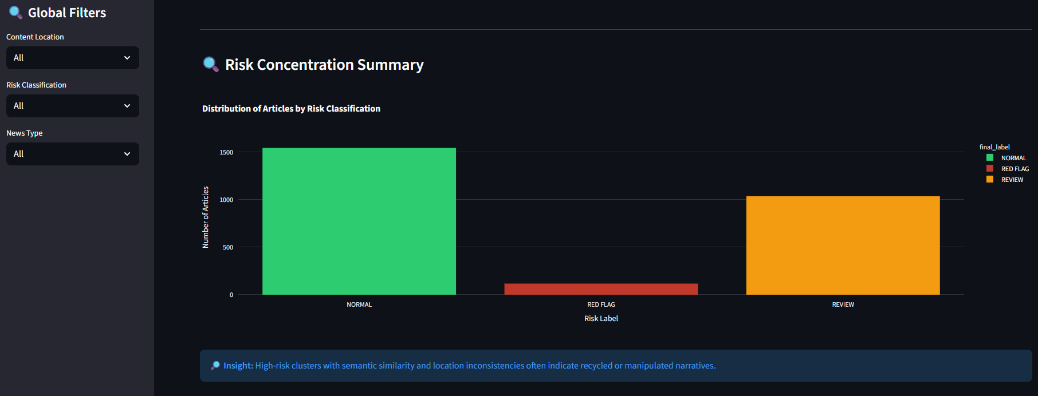
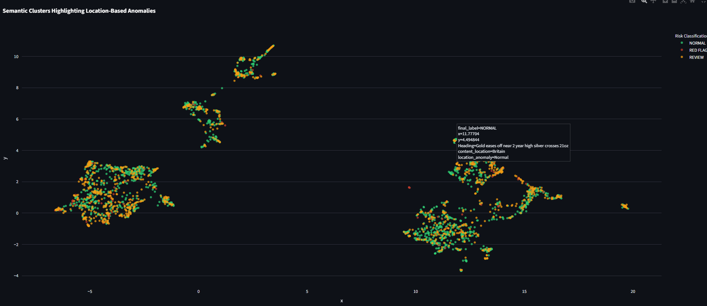
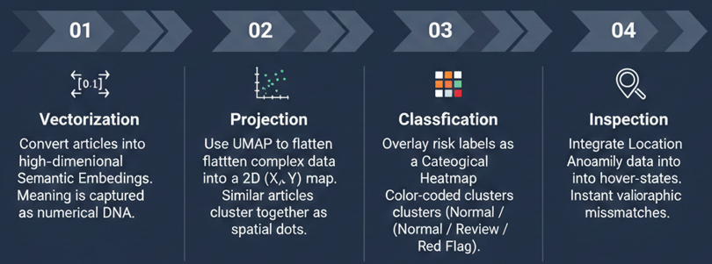
Visualization – Tab1
Disinformation Detection
Inference:
Similar articles with elevated risk are potentially coordinated narratives
Same story, different places is classic sign of recycled or misleading content.
Dense areas indicate strong narrative repetition; sparse areas are unique or outlier stories.

Slide 13
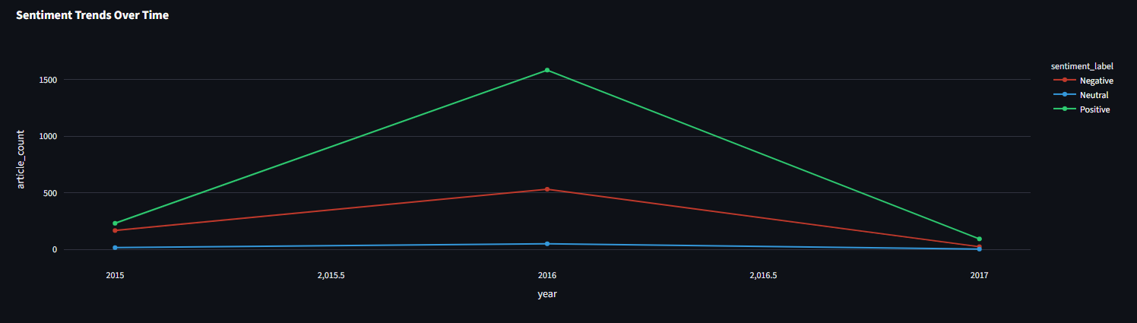
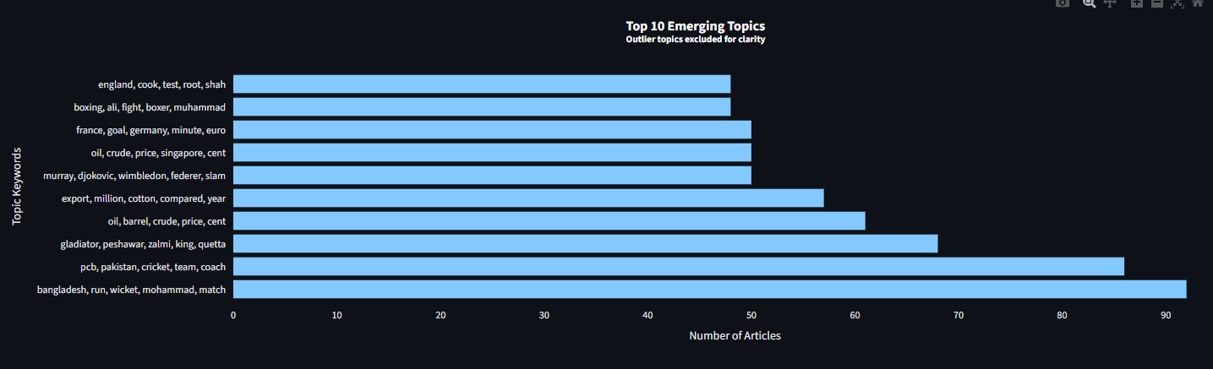
Visualization-Tab2
Hyperlocal Trend monitoring
Sentiment trends:
If negativity spikes in certain years, it may signal crises, manipulation, or coordinated campaigns.
If positivity rises, it may reflect recovery or positive narratives.
Neutral coverage shows stability.
Topic dominance:
Top topics highlight what the media is focusing on (e.g., energy, politics, health).
Emerging topics show new narratives gaining attention.

Slide 14
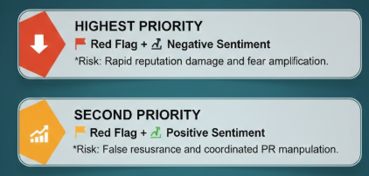
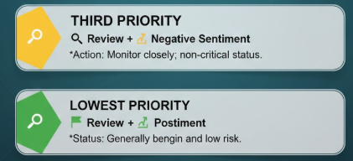
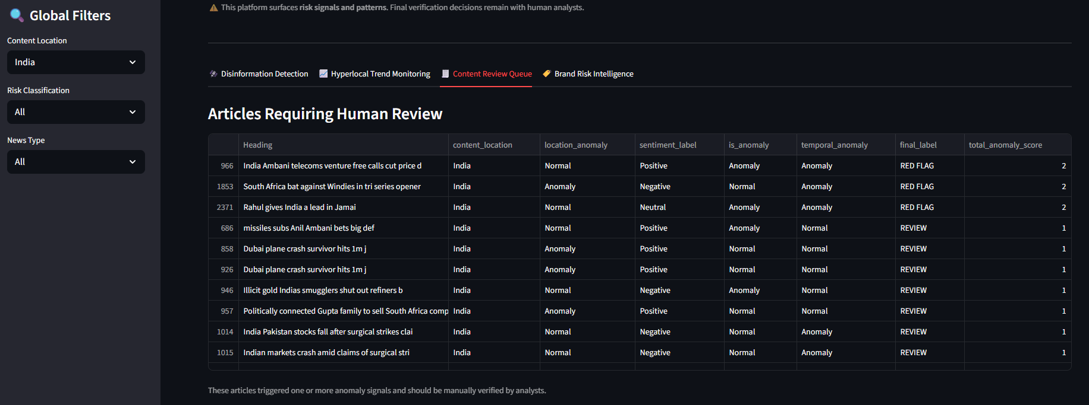
Visualization-Tab3
Content Review

Slide 15
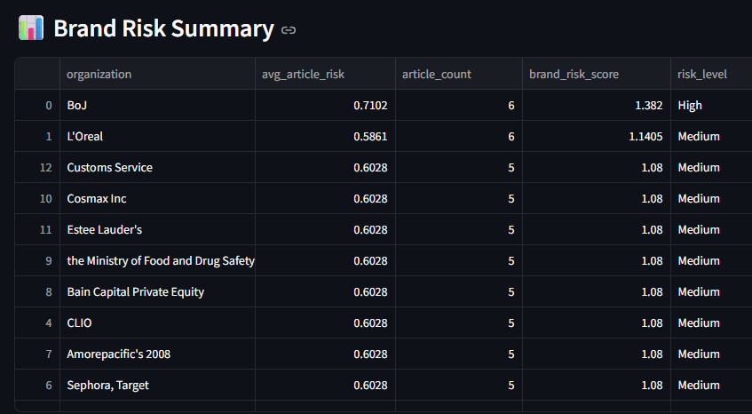
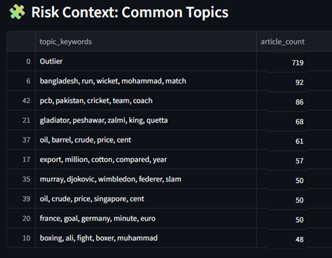
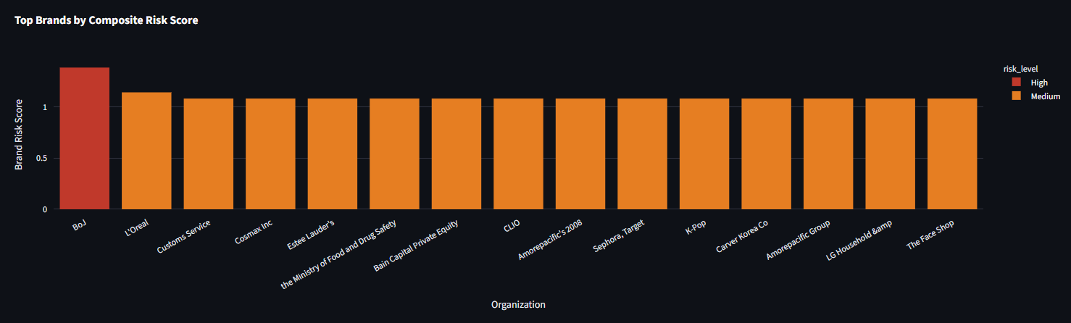
Visualization-Tab4
Brand Risk
Organizations repeatedly exposed to anomalous coverage is high risk brands
Nature of risk: Whether it’s driven by negative sentiment, location mismatches, or spikes in volume.
Narrative context: Which topics are linked to brand risk (e.g., energy, politics, health).
Actionable insight: Stakeholders can see not just that they’re at risk, but why.

